Slide 1
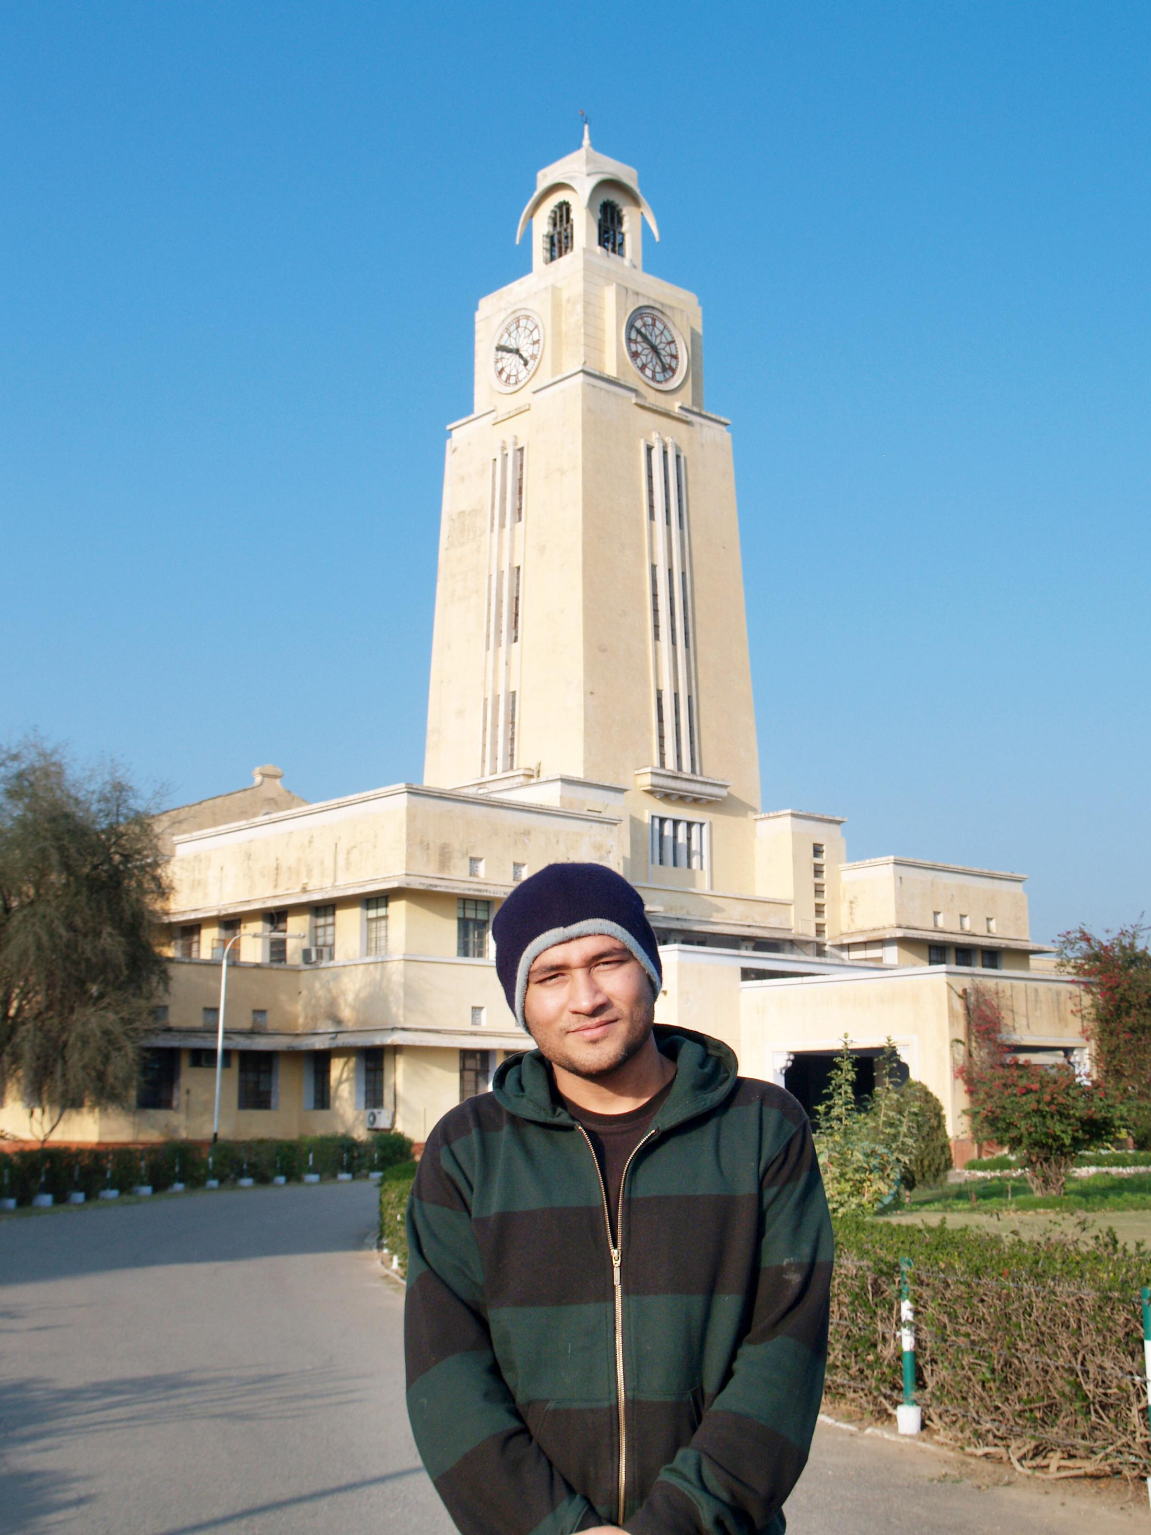

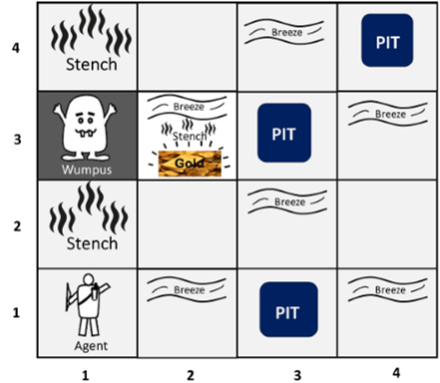

BITS Pilani
Pilani Campus
(some slides adapted from Stuart http://aima.cs.berkeley.edu/)
DSE CL 557 - Artificial and Computational Intelligence
#9. Logical Agent
Sunday, January 17, 2021
Dr. Saikishor Jangiti

Slide 2
Today
Knowledge-based agents
Wumpus world
Logic in general - models and entailment
Propositional (Boolean) logic
Equivalence, validity, satisfiability
Inference rules and theorem proving
forward chaining
backward chaining
resolution
Reference: Chapter 7.1 to 7.5 from AI: A modern approach (Russell, Norvig)

Slide 3
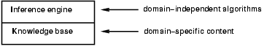
Knowledge bases
Knowledge base = set of sentences in a formal language
Declarative approach to building an agent (or other system):
Tell it what it needs to know
Then it can Ask itself what to do - answers should follow from the KB
Agents can be viewed at the knowledge level
i.e., what they know, regardless of how implemented
Or at the implementation level
i.e., data structures in KB and algorithms that manipulate them

Slide 4
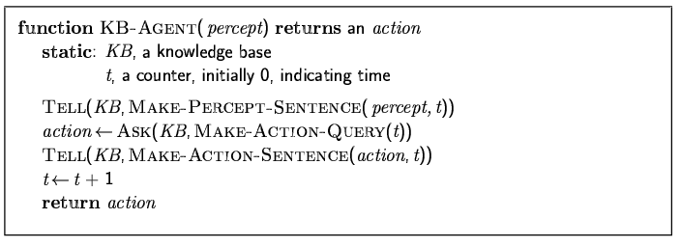
A simple knowledge-based agent
The agent must be able to:
Represent states, actions, etc.
Incorporate new percepts
Update internal representations of the world
Deduce hidden properties of the world
Deduce appropriate actions

Slide 5
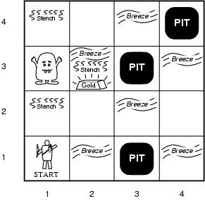
Wumpus World PEAS description
Performance measure
gold +1000, death -1000
-1 per step, -10 for using the arrow
Environment
Squares adjacent to wumpus are smelly
Squares adjacent to pit are breezy
Glitter iff gold is in the same square
Shooting kills wumpus if you are facing it
Shooting uses up the only arrow
Grabbing picks up gold if in same square
Releasing drops the gold in same square
Sensors: Stench, Breeze, Glitter, Bump, Scream
Actuators: Left turn, Right turn, Forward, Grab, Release, Shoot

Slide 6
Wumpus world characterization
Fully Observable No – only local perception
Deterministic Yes – outcomes exactly specified
Episodic No – sequential at the level of actions
Static Yes – Wumpus and Pits do not move
Discrete Yes
Single-agent? Yes – Wumpus is essentially a natural feature

Slide 7
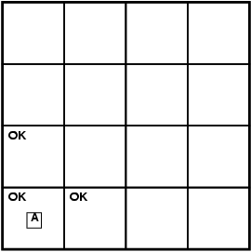
Exploring a wumpus world

Slide 8
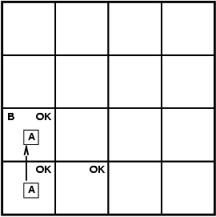
Exploring a wumpus world

Slide 9
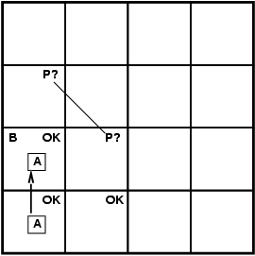
Exploring a wumpus world

Slide 10
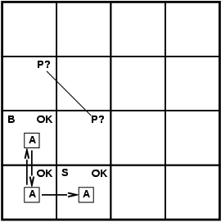
Exploring a wumpus world

Slide 11
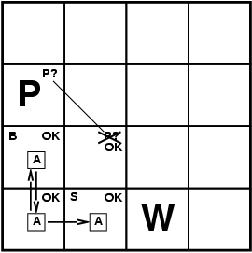
Exploring a wumpus world

Slide 12

Exploring a wumpus world

Slide 13
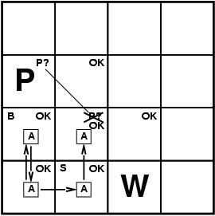
Exploring a wumpus world

Slide 14
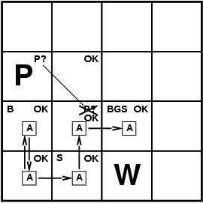
Exploring a wumpus world

Slide 15
Logic in general
Logics are formal languages for representing information such that conclusions can be drawn
Syntax defines the sentences in the language
Semantics define the "meaning" of sentences;
i.e., define truth of a sentence in a world
E.g., the language of arithmetic
x+2 ≥ y is a sentence; x2+y > {} is not a sentence
x+2 ≥ y is true iff the number x+2 is no less than the number y
x+2 ≥ y is true in a world where x = 7, y = 1
x+2 ≥ y is false in a world where x = 0, y = 6

Slide 16
Entailment
Entailment means that one thing follows from another:
KB ╞ α
Knowledge base KB entails sentence α if and only if α is true in all worlds where KB is true
E.g., the KB containing “the Giants won” and “the Reds won” entails “Either the Giants won or the Reds won”
E.g., x+y = 4 entails 4 = x+y
Entailment is a relationship between sentences (i.e., syntax) that is based on semantics

Slide 17
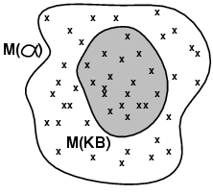
Models
Logicians typically think in terms of models, which are formally structured worlds with respect to which truth can be evaluated
We say m is a model of a sentence α if α is true in m
M(α) is the set of all models of α
^{Then KB ╞ α iff M(KB) ⊆ M(α)}
^{E.g. KB = Giants won and Reds} ^{won α = Giants won}

Slide 18
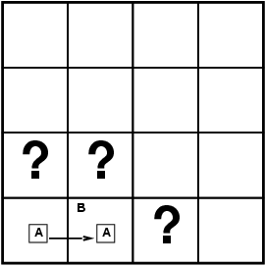
Entailment in the wumpus world
Situation after detecting nothing in [1,1], moving right, breeze in [2,1]
Consider possible models for KB assuming only pits
3 Boolean choices ⇒ 8 possible models

Slide 19
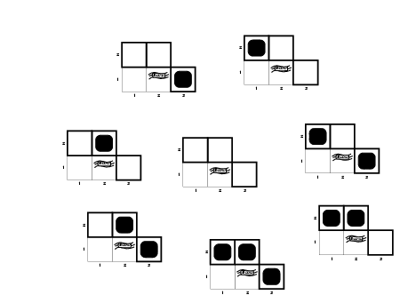
Wumpus models

Slide 20
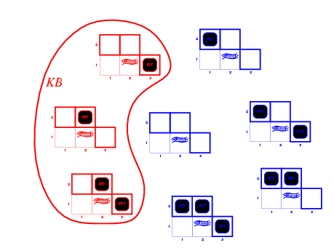
Wumpus models
KB = wumpus-world rules + observations

Slide 21
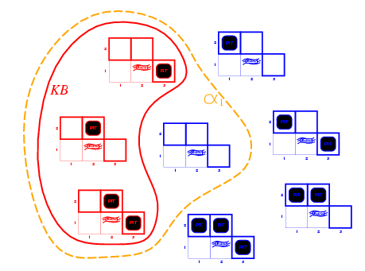
Wumpus models
KB = wumpus-world rules + observations
α₁ = "[1,2] is safe", KB ╞ α₁, proved by model checking

Slide 22
Wumpus models
KB = wumpus-world rules + observations

Slide 23
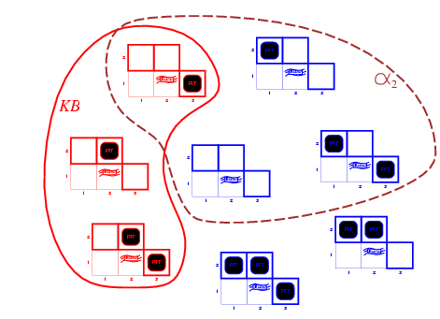
Wumpus models
KB = wumpus-world rules + observations
α₂ = "[2,2] is safe", KB ╞ α₂

Slide 24
Inference
KB ├_{i} α = sentence α can be derived from KB by procedure i
Soundness: i is sound if whenever KB ├_{i} α, it is also true that KB╞ α
Completeness: i is complete if whenever KB╞ α, it is also true that KB ├_{i} α
Preview: we will define a logic (first-order logic) which is expressive enough to say almost anything of interest, and for which there exists a sound and complete inference procedure.
That is, the procedure will answer any question whose answer follows from what is known by the KB.

Slide 25
Propositional logic: Syntax
Propositional logic is the simplest logic – illustrates basic ideas
The proposition symbols P₁, P₂ etc are sentences
If S is a sentence, ¬S is a sentence (negation)
If S₁ and S₂ are sentences, S₁ ∧ S₂ is a sentence (conjunction)
If S₁ and S₂ are sentences, S₁ ∨ S₂ is a sentence (disjunction)
If S₁ and S₂ are sentences, S₁ ⇒ S₂ is a sentence (implication)
If S₁ and S₂ are sentences, S₁ ⇔ S₂ is a sentence (biconditional)

Slide 26
Propositional logic: Semantics
Each model specifies true/false for each proposition symbol
E.g. P_{1,2} P_{2,2} P_{3,1}
false true false
With these symbols, 8 possible models, can be enumerated automatically.
Rules for evaluating truth with respect to a model m:
¬S is true iff S is false
S₁ ∧ S₂ is true iff S₁ is true and S₂ is true
S₁ ∨ S₂ is true iff S₁ is true or S₂ is true
S₁ ⇒ S₂ is true iff S₁ is false or S₂ is true
i.e., is false iff S₁ is true and S₂ is false
S₁ ⇔ S₂ is true iff S₁⇒S₂ is true andS₂⇒S₁ is true
Simple recursive process evaluates an arbitrary sentence, e.g.,
¬P_{1,2} ∧ (P_{2,2} ∨ P_{3,1}) = true ∧ (true ∨ false) = true ∧ true = true

Slide 27
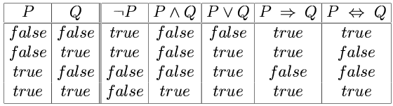
Truth tables for connectives

Slide 28
Wumpus world sentences
Let P_{i,j} be true if there is a pit in [i, j].
Let B_{i,j} be true if there is a breeze in [i, j].
¬ P_{1,1}
¬B_{1,1}
B_{2,1}
"Pits cause breezes in adjacent squares"
B_{1,1} ⇔ (P_{1,2} ∨ P_{2,1})
B_{2,1} ⇔ (P_{1,1} ∨ P_{2,2} ∨ P_{3,1})

Slide 29
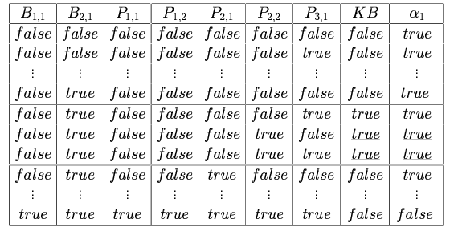
Truth tables for inference

Slide 30
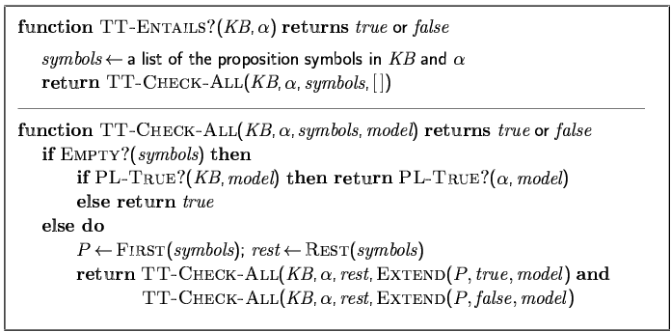
Inference by enumeration
Depth-first enumeration of all models is sound and complete
For n symbols, time complexity is O(2^{n}), space complexity is O(n)

Slide 31
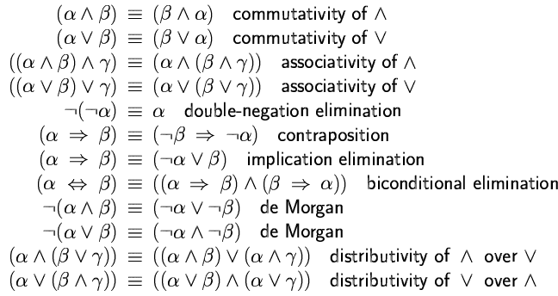
Logical equivalence
Two sentences are logically equivalent
iff true in same models: α ≡ ß iff α╞ β and β╞ α

Slide 32
Validity and satisfiability
A sentence is valid if it is true in all models,
e.g., True, A ∨¬A, A ⇒ A, (A ∧ (A ⇒ B)) ⇒ B
Validity is connected to inference via the Deduction Theorem:
KB ╞ α if and only if (KB ⇒ α) is valid
A sentence is satisfiable if it is true in some model
e.g., A∨ B, C
A sentence is unsatisfiable if it is true in no models
e.g., A∧¬A
Satisfiability is connected to inference via the following:
KB ╞ α if and only if (KB ∧¬α) is unsatisfiable

Slide 33
Proof methods
Proof methods divide into (roughly) two kinds:
Application of inference rules
Legitimate (sound) generation of new sentences from old
Proof = a sequence of inference rule applications Can use inference rules as operators in a standard search algorithm
Typically require transformation of sentences into a normal form
Model checking
truth table enumeration (always exponential in n)
improved backtracking, e.g., Davis--Putnam-Logemann-Loveland (DPLL)
heuristic search in model space (sound but incomplete)
e.g., min-conflicts-like hill-climbing algorithms

Slide 34
Resolution
Conjunctive Normal Form (CNF)
conjunction of disjunctions of literals
clauses
E.g., (A ∨ ¬B) ∧ (B ∨ ¬C ∨ ¬D)
Resolution inference rule (for CNF):
l_{i} ∨… ∨ l_{k}, m₁ ∨ … ∨ m_{n}
l_{i} ∨ … ∨ l_{i-1} ∨ l_{i+1} ∨ … ∨ l_{k} ∨ m₁ ∨ … ∨ m_{j-1} ∨ m_{j+1} ∨... ∨ m_{n}
where l_{i} and m_{j} are complementary literals.
E.g., P_{1,3} ∨ P_{2,2}, ¬P_{2,2}
P_{1,3}
Resolution is sound and complete for propositional logic

Slide 35
Resolution
Soundness of resolution inference rule:
¬(l_{i} ∨ … ∨ l_{i-1} ∨ l_{i+1} ∨ … ∨ l_{k}) ⇒ l_{i}
¬m_{j} ⇒ (m₁ ∨ … ∨ m_{j-1} ∨ m_{j+1} ∨... ∨ m_{n})
¬(l_{i} ∨ … ∨ l_{i-1} ∨ l_{i+1} ∨ … ∨ l_{k}) ⇒ (m₁ ∨ … ∨ m_{j-1} ∨ m_{j+1} ∨... ∨ m_{n})

Slide 36
Conversion to CNF
B_{1,1} ⇔ (P_{1,2} ∨ P_{2,1})β
Eliminate ⇔, replacing α ⇔ β with (α ⇒ β)∧(β ⇒ α).
(B_{1,1} ⇒ (P_{1,2} ∨ P_{2,1})) ∧ ((P_{1,2} ∨ P_{2,1}) ⇒ B_{1,1})
2. Eliminate ⇒, replacing α ⇒ β with ¬α∨ β.
(¬B_{1,1} ∨ P_{1,2} ∨ P_{2,1}) ∧ (¬(P_{1,2} ∨ P_{2,1}) ∨ B_{1,1})
3. Move ¬ inwards using de Morgan's rules and double-negation:
(¬B_{1,1} ∨ P_{1,2} ∨ P_{2,1}) ∧ ((¬P_{1,2} ∨ ¬P_{2,1}) ∨ B_{1,1})
4. Apply distributivity law (∧ over ∨) and flatten:
(¬B_{1,1} ∨ P_{1,2} ∨ P_{2,1}) ∧ (¬P_{1,2} ∨ B_{1,1}) ∧ (¬P_{2,1} ∨ B_{1,1})

Slide 37
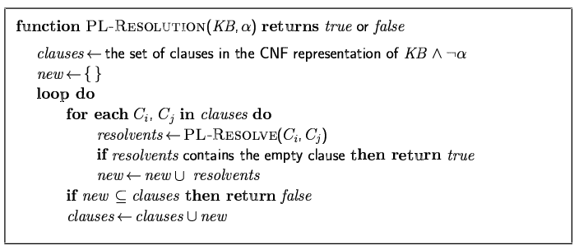
Resolution algorithm
Proof by contradiction, i.e., show KB∧¬α unsatisfiable

Slide 38
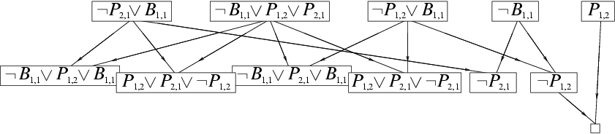
Resolution example
KB = (B_{1,1} ⇔ (P_{1,2}∨ P_{2,1})) ∧¬ B_{1,1} α = ¬P_{1,2}

Slide 39
Forward and backward chaining
Horn Form (restricted)
KB = conjunction of Horn clauses
Horn clause =
proposition symbol; or
(conjunction of symbols) ⇒ symbol
E.g., C ∧ (B ⇒ A) ∧ (C ∧ D ⇒ B)
Modus Ponens (for Horn Form): complete for Horn KBs
α₁, … ,α_{n}, α₁ ∧ … ∧ α_{n} ⇒ β
β
Can be used with forward chaining or backward chaining.
These algorithms are very natural and run in linear time

Slide 40
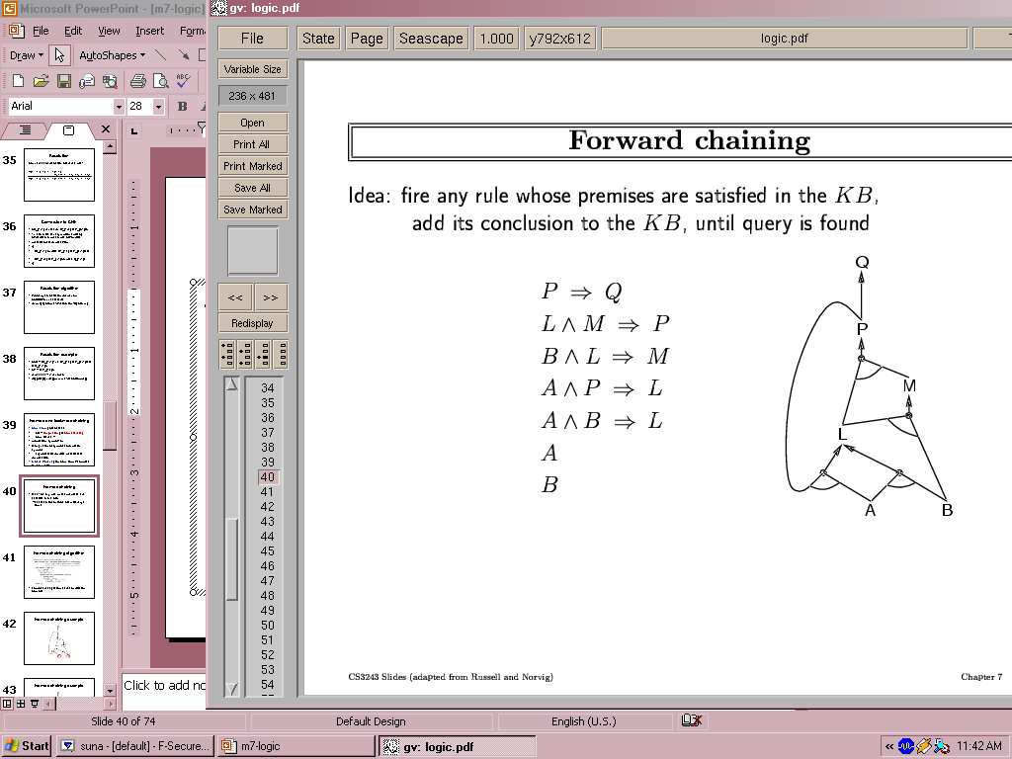
Forward chaining
Idea: fire any rule whose premises are satisfied in the KB,
add its conclusion to the KB, until query is found

Slide 41
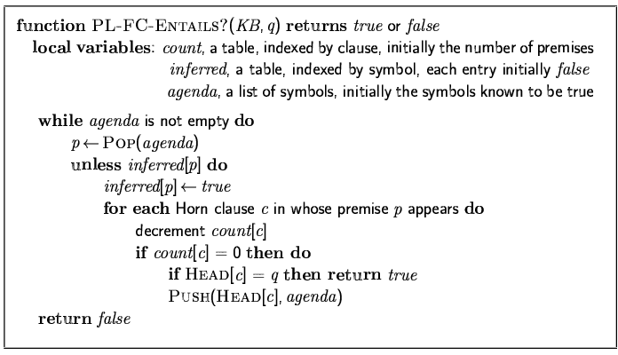
Forward chaining algorithm
Forward chaining is sound and complete for Horn KB

Slide 42
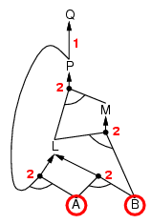
Forward chaining example

Slide 43
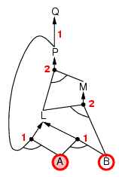
Forward chaining example

Slide 44
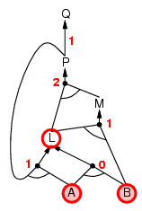
Forward chaining example

Slide 45
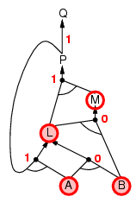
Forward chaining example

Slide 46
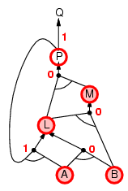
Forward chaining example

Slide 47
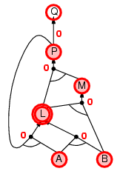
Forward chaining example

Slide 48
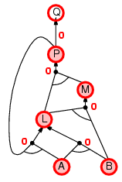
Forward chaining example

Slide 49

Forward chaining example

Slide 50
Proof of completeness
FC derives every atomic sentence that is entailed by KB
FC reaches a fixed point where no new atomic sentences are derived
Consider the final state as a model m, assigning true/false to symbols
Every clause in the original KB is true in m
a₁ ∧ … ∧ a_{k ⇒} b
Hence m is a model of KB
If KB╞ q, q is true in every model of KB, including m

Slide 51
Backward chaining
Idea: work backwards from the query q:
to prove q by BC,
check if q is known already, or
prove by BC all premises of some rule concluding q
Avoid loops: check if new subgoal is already on the goal stack
Avoid repeated work: check if new subgoal
has already been proved true, or
has already failed

Slide 52
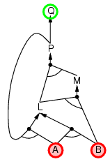
Backward chaining example

Slide 53
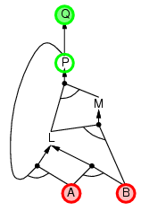
Backward chaining example

Slide 54
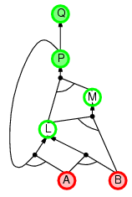
Backward chaining example

Slide 55
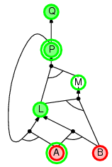
Backward chaining example

Slide 56
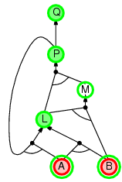
Backward chaining example

Slide 57
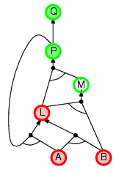
Backward chaining example

Slide 58
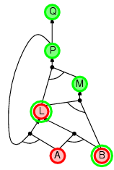
Backward chaining example

Slide 59
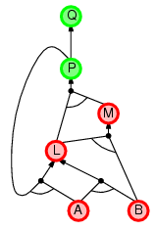
Backward chaining example

Slide 60
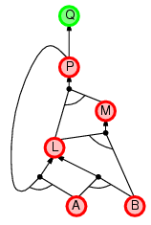
Backward chaining example

Slide 61
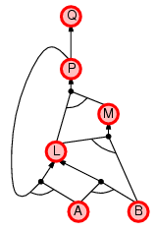
Backward chaining example

Slide 62
Forward vs. backward chaining
FC is data-driven, automatic, unconscious processing,
e.g., object recognition, routine decisions
May do lots of work that is irrelevant to the goal
BC is goal-driven, appropriate for problem-solving,
e.g., Where are my keys? How do I get into a PhD program?
Complexity of BC can be much less than linear in size of KB

Slide 63
Efficient propositional inference
Two families of efficient algorithms for propositional inference:
Complete backtracking search algorithms
DPLL algorithm (Davis, Putnam, Logemann, Loveland)
Incomplete local search algorithms
WalkSAT algorithm

Slide 64
The DPLL algorithm
Determine if an input propositional logic sentence (in CNF) is satisfiable.
Improvements over truth table enumeration:
Early termination
A clause is true if any literal is true.
A sentence is false if any clause is false.
Pure symbol heuristic
Pure symbol: always appears with the same "sign" in all clauses.
e.g., In the three clauses (A ∨ ¬B), (¬B ∨ ¬C), (C ∨ A), A and B are pure, C is impure.
Make a pure symbol literal true.
Unit clause heuristic
Unit clause: only one literal in the clause
The only literal in a unit clause must be true.

Slide 65
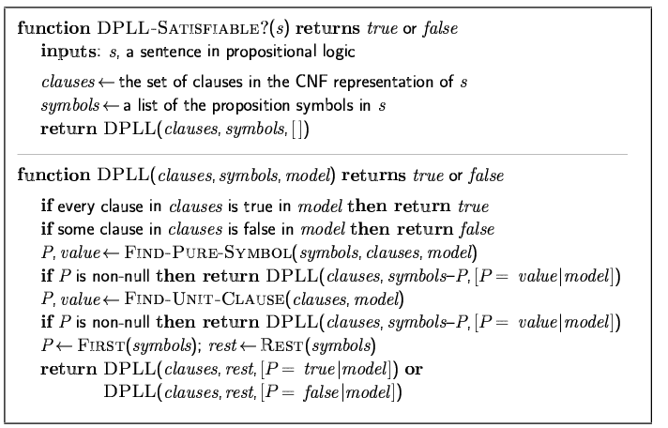
The DPLL algorithm

Slide 66
The WalkSAT algorithm
Incomplete, local search algorithm
Evaluation function: The min-conflict heuristic of minimizing the number of unsatisfied clauses
Balance between greediness and randomness

Slide 67
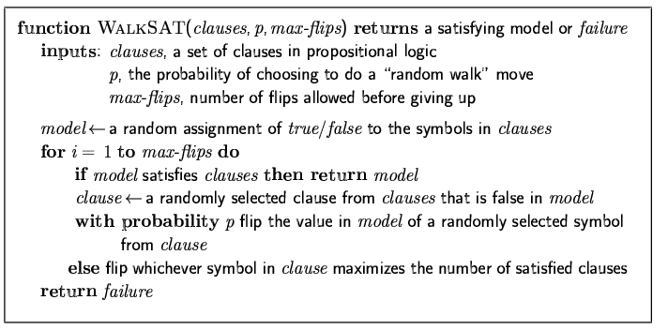
The WalkSAT algorithm

Slide 68
Hard satisfiability problems
Consider random 3-CNF sentences. e.g.,
(¬D ∨ ¬B ∨ C) ∧ (B ∨ ¬A ∨ ¬C) ∧ (¬C ∨ ¬B ∨ E) ∧ (E ∨ ¬D ∨ B) ∧ (B ∨ E ∨ ¬C)
m = number of clauses
n = number of symbols
Hard problems seem to cluster near m/n = 4.3 (critical point)

Slide 69
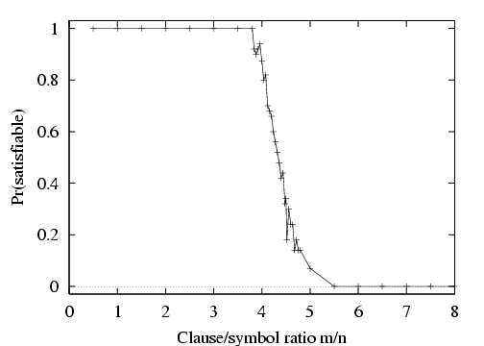
Hard satisfiability problems

Slide 70
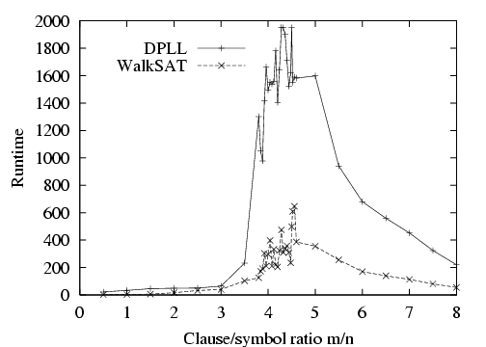
Hard satisfiability problems
Median runtime for 100 satisfiable random 3-CNF sentences, n = 50

Slide 71
Inference-based agents in the wumpus world
A wumpus-world agent using propositional logic:
¬P_{1,1}
¬W_{1,1}
B_{x,y} ⇔ (P_{x,y+1} ∨ P_{x,y-1} ∨ P_{x+1,y} ∨ P_{x-1,y})
S_{x,y} ⇔ (W_{x,y+1} ∨ W_{x,y-1} ∨ W_{x+1,y} ∨ W_{x-1,y})
W_{1,1} ∨ W_{1,2} ∨ … ∨ W_{4,4}
¬W_{1,1} ∨ ¬W_{1,2}
¬W_{1,1} ∨ ¬W_{1,3}
…
⇒ 64 distinct proposition symbols, 155 sentences

Slide 72
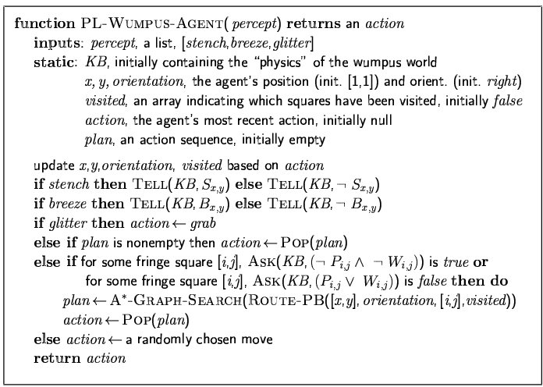

Slide 73
Expressiveness limitation of propositional logic
KB contains "physics" sentences for every single square
For every time t and every location [x,y],
L_{x,y} ∧ FacingRight^{t} ∧ Forward^{t} ⇒ L_{x+1,y}
Rapid proliferation of clauses
t
t

Slide 74
Summary
Logical agents apply inference to a knowledge base to derive new information and make decisions
Basic concepts of logic:
syntax: formal structure of sentences
semantics: truth of sentences wrt models
entailment: necessary truth of one sentence given another
inference: deriving sentences from other sentences
soundness: derivations produce only entailed sentences
completeness: derivations can produce all entailed sentences
Wumpus world requires the ability to represent partial and negated information, reason by cases, etc.
Resolution is complete for propositional logic Forward, backward chaining are linear-time, complete for Horn clauses
Propositional logic lacks expressive power

Slide 75
Thank you for your Attention
Any more queries

Slide 76
BITS Pilani
Pilani Campus
(some slides adapted from Stuart http://aima.cs.berkeley.edu/)
DSE CL 557 - Artificial and Computational Intelligence
#10. Logical Agent (Cont..)
Sunday, January 17, 2021
Dr. Saikishor Jangiti

Slide 77
Today
Inference rules and theorem proving
Forward chaining
Backward chaining
Resolution
DPLL Algorithm
Agents based on Propositional logic
Overview of FOL semantics and representation
Reference: Chapter 7.5 to 7.7 & 8.1 from AI: A modern approach (Russell, Norvig)

Slide 78
Resolution algorithm
Proof by contradiction, i.e., show KB∧¬α unsatisfiable

Slide 79
Resolution example
KB = (B_{1,1} ⇔ (P_{1,2}∨ P_{2,1})) ∧¬ B_{1,1} α = ¬P_{1,2}

Slide 80
Forward and backward chaining
Horn Form (restricted)
KB = conjunction of Horn clauses
Horn clause =
proposition symbol; or
(conjunction of symbols) ⇒ symbol
E.g., C ∧ (B ⇒ A) ∧ (C ∧ D ⇒ B)
Modus Ponens (for Horn Form): complete for Horn KBs
α₁, … ,α_{n}, α₁ ∧ … ∧ α_{n} ⇒ β
β
Can be used with forward chaining or backward chaining.
These algorithms are very natural and run in linear time

Slide 81
Forward chaining
Idea: fire any rule whose premises are satisfied in the KB,
add its conclusion to the KB, until query is found

Slide 82
Forward chaining algorithm
Forward chaining is sound and complete for Horn KB

Slide 83
Forward chaining example

Slide 84
Forward chaining example

Slide 85
Forward chaining example

Slide 86
Forward chaining example

Slide 87
Forward chaining example

Slide 88
Forward chaining example

Slide 89
Forward chaining example

Slide 90
Forward chaining example

Slide 91
Proof of completeness
FC derives every atomic sentence that is entailed by KB
FC reaches a fixed point where no new atomic sentences are derived
Consider the final state as a model m, assigning true/false to symbols
Every clause in the original KB is true in m
a₁ ∧ … ∧ a_{k ⇒} b
Hence m is a model of KB
If KB╞ q, q is true in every model of KB, including m

Slide 92
Backward chaining
Idea: work backwards from the query q:
to prove q by BC,
check if q is known already, or
prove by BC all premises of some rule concluding q
Avoid loops: check if new subgoal is already on the goal stack
Avoid repeated work: check if new subgoal
has already been proved true, or
has already failed

Slide 93
Backward chaining example

Slide 94
Backward chaining example

Slide 95
Backward chaining example

Slide 96
Backward chaining example

Slide 97
Backward chaining example

Slide 98
Backward chaining example

Slide 99
Backward chaining example

Slide 100
Backward chaining example

Slide 101
Backward chaining example

Slide 102
Backward chaining example

Slide 103
Forward vs. backward chaining
FC is data-driven, automatic, unconscious processing,
e.g., object recognition, routine decisions
May do lots of work that is irrelevant to the goal
BC is goal-driven, appropriate for problem-solving,
e.g., Where are my keys? How do I get into a PhD program?
Complexity of BC can be much less than linear in size of KB

Slide 104
Efficient propositional inference
Two families of efficient algorithms for propositional inference:
Complete backtracking search algorithms
DPLL algorithm (Davis, Putnam, Logemann, Loveland)
Incomplete local search algorithms
WalkSAT algorithm

Slide 105
The DPLL algorithm
Determine if an input propositional logic sentence (in CNF) is satisfiable.
Improvements over truth table enumeration:
Early termination
A clause is true if any literal is true.
A sentence is false if any clause is false.
Pure symbol heuristic
Pure symbol: always appears with the same "sign" in all clauses.
e.g., In the three clauses (A ∨ ¬B), (¬B ∨ ¬C), (C ∨ A), A and B are pure, C is impure.
Make a pure symbol literal true.
Unit clause heuristic
Unit clause: only one literal in the clause
The only literal in a unit clause must be true.

Slide 106
The DPLL algorithm

Slide 107
Inference-based agents in the wumpus world
A wumpus-world agent using propositional logic:
¬P_{1,1}
¬W_{1,1}
B_{x,y} ⇔ (P_{x,y+1} ∨ P_{x,y-1} ∨ P_{x+1,y} ∨ P_{x-1,y})
S_{x,y} ⇔ (W_{x,y+1} ∨ W_{x,y-1} ∨ W_{x+1,y} ∨ W_{x-1,y})
W_{1,1} ∨ W_{1,2} ∨ … ∨ W_{4,4}
¬W_{1,1} ∨ ¬W_{1,2}
¬W_{1,1} ∨ ¬W_{1,3}
…
⇒ 64 distinct proposition symbols, 155 sentences

Slide 108
Expressiveness limitation of propositional logic
KB contains "physics" sentences for every single square
For every time t and every location [x,y],
L_{x,y} ∧ FacingRight^{t} ∧ Forward^{t} ⇒ L_{x+1,y}
Rapid proliferation of clauses
t
t

Slide 109
Pros and cons of propositional logic
☺ Propositional logic is declarative
☺ Propositional logic allows partial/disjunctive/negated information
(unlike most data structures and databases)
Propositional logic is compositional:
meaning of B_{1,1} ∧ P_{1,2} is derived from meaning of B_{1,1} and of P_{1,2}
☺ Meaning in propositional logic is context-independent
(unlike natural language, where meaning depends on context)
☹ Propositional logic has very limited expressive power
(unlike natural language)
E.g., cannot say "pits cause breezes in adjacent squares“
except by writing one sentence for each square

Slide 110
First-order logic
Whereas propositional logic assumes the world contains facts,
first-order logic (like natural language) assumes the world contains
Objects: people, houses, numbers, colors, baseball games, wars, …
Relations: red, round, prime, brother of, bigger than, part of, comes between, …
Functions: father of, best friend, one more than, plus, …

Slide 111
Syntax of FOL: Basic elements
Constants KingJohn, 2, NUS,...
Predicates Brother, >,...
Functions Sqrt, LeftLegOf,...
Variables x, y, a, b,...
Connectives ¬, ⇒, ∧, ∨, ⇔
Equality =
Quantifiers ∀, ∃

Slide 112
Atomic sentences
Atomic sentence = predicate (term₁,...,term_{n}) or term₁ = term₂
Term = function (term₁,...,term_{n}) or constant or variable
E.g., Brother(KingJohn,RichardTheLionheart) > (Length(LeftLegOf(Richard)), Length(LeftLegOf(KingJohn)))

Slide 113
Complex sentences
Complex sentences are made from atomic sentences using connectives
¬S, S₁ ∧ S₂, S₁ ∨ S₂, S₁ ⇒ S₂, S₁ ⇔ S₂,
E.g. Sibling(KingJohn,Richard) ⇒ Sibling(Richard,KingJohn)
>(1,2) ∨ ≤ (1,2)
>(1,2) ∧ ¬ >(1,2)

Slide 114
Truth in first-order logic
Sentences are true with respect to a model and an interpretation
Model contains objects (domain elements) and relations among them
Interpretation specifies referents for
constant symbols → objects
predicate symbols → relations
function symbols → functional relations
An atomic sentence predicate(term₁,...,term_{n}) is true
iff the objects referred to by term₁,...,term_{n}
are in the relation referred to by predicate

Slide 115
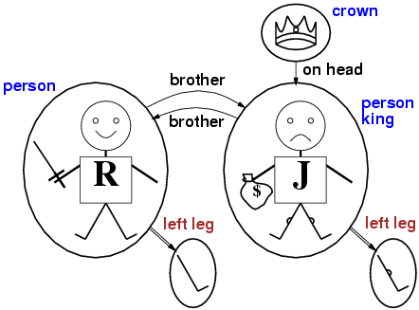
Models for FOL: Example

Slide 116
Universal quantification
∀<variables> <sentence>
Everyone at NUS is smart:
∀x At(x,NUS) ⇒ Smart(x)
∀x P is true in a model m iff P is true with x being each possible object in the model
Roughly speaking, equivalent to the conjunction of instantiations of P
At(KingJohn,NUS) ⇒ Smart(KingJohn)
∧ At(Richard,NUS) ⇒ Smart(Richard)
∧ At(NUS,NUS) ⇒ Smart(NUS)
∧ ...

Slide 117
A common mistake to avoid
Typically, ⇒ is the main connective with ∀
Common mistake: using ∧ as the main connective with ∀:
∀x At(x,NUS) ∧ Smart(x)
means “Everyone is at NUS and everyone is smart”

Slide 118
Existential quantification
∃<variables> <sentence>
Someone at NUS is smart:
∃x At(x,NUS) ∧ Smart(x)$
∃x P is true in a model m iff P is true with x being some possible object in the model
Roughly speaking, equivalent to the disjunction of instantiations of P
At(KingJohn,NUS) ∧ Smart(KingJohn)
∨ At(Richard,NUS) ∧ Smart(Richard)
∨ At(NUS,NUS) ∧ Smart(NUS)
∨ ...

Slide 119
Another common mistake to avoid
Typically, ∧ is the main connective with ∃
Common mistake: using ⇒ as the main connective with ∃:
∃x At(x,NUS) ⇒ Smart(x)
is true if there is anyone who is not at NUS!

Slide 120
Properties of quantifiers
∀x ∀y is the same as ∀y ∀x
∃x ∃y is the same as ∃y ∃x
∃x ∀y is not the same as ∀y ∃x
∃x ∀y Loves(x,y)
“There is a person who loves everyone in the world”
∀y ∃x Loves(x,y)
“Everyone in the world is loved by at least one person”
Quantifier duality: each can be expressed using the other
∀x Likes(x,IceCream) ¬∃x ¬Likes(x,IceCream)
∃x Likes(x,Broccoli) ¬∀x ¬Likes(x,Broccoli)

Slide 121
Equality
term₁ = term₂ is true under a given interpretation if and only if term₁ and term₂ refer to the same object
E.g., definition of Sibling in terms of Parent:
∀x,y Sibling(x,y) ⇔ [¬(x = y) ∧ ∃m,f ¬ (m = f) ∧ Parent(m,x) ∧ Parent(f,x) ∧ Parent(m,y) ∧ Parent(f,y)]

Slide 122
Using FOL
The kinship domain:
Brothers are siblings
∀x,y Brother(x,y) ⇔ Sibling(x,y)
One's mother is one's female parent
∀m,c Mother(c) = m ⇔ (Female(m) ∧ Parent(m,c))
“Sibling” is symmetric
∀x,y Sibling(x,y) ⇔ Sibling(y,x)

Slide 123
Using FOL
The set domain:
∀s Set(s) ⇔ (s = {} ) ∨ (∃x,s₂ Set(s₂) ∧ s = {x|s₂})
¬∃x,s {x|s} = {}
∀x,s x ∈ s ⇔ s = {x|s}
∀x,s x ∈ s ⇔ [ ∃y,s₂} (s = {y|s₂} ∧ (x = y ∨ x ∈ s₂))]
∀s₁,s₂ s₁ ⊆ s₂ ⇔ (∀x x ∈ s₁ ⇒ x ∈ s₂)
∀s₁,s₂ (s₁ = s₂) ⇔ (s₁ ⊆ s₂ ∧ s₂ ⊆ s₁)
∀x,s₁,s₂ x ∈ (s₁ ∩ s₂) ⇔ (x ∈ s₁ ∧ x ∈ s₂)
∀x,s₁,s₂ x ∈ (s₁ ∪ s₂) ⇔ (x ∈ s₁ ∨ x ∈ s₂)

Slide 124
Interacting with FOL KBs
Suppose a wumpus-world agent is using an FOL KB and perceives a smell and a breeze (but no glitter) at t=5:
Tell(KB,Percept([Smell,Breeze,None],5))
Ask(KB,∃a BestAction(a,5))
I.e., does the KB entail some best action at t=5?
Answer: Yes, {a/Shoot} ← substitution (binding list)
Given a sentence S and a substitution σ,
Sσ denotes the result of plugging σ into S; e.g.,
S = Smarter(x,y)
σ = {x/Hillary,y/Bill}
Sσ = Smarter(Hillary,Bill)
Ask(KB,S) returns some/all σ such that KB╞ σ

Slide 125
Knowledge base for the wumpus world
Perception
∀t,s,b Percept([s,b,Glitter],t) ⇒ Glitter(t)
Reflex
∀t Glitter(t) ⇒ BestAction(Grab,t)

Slide 126
Deducing hidden properties
∀x,y,a,b Adjacent([x,y],[a,b]) ⇔
[a,b] ∈ {[x+1,y], [x-1,y],[x,y+1],[x,y-1]}
Properties of squares:
∀s,t At(Agent,s,t) ∧ Breeze(t) ⇒ Breezy(s)
Squares are breezy near a pit:
Diagnostic rule---infer cause from effect
∀s Breezy(s) ⇒ \Exi{r} Adjacent(r,s) ∧ Pit(r)$
Causal rule---infer effect from cause
∀r Pit(r) ⇒ [∀s Adjacent(r,s) ⇒ Breezy(s)$ ]

Slide 127
Summary
First-order logic:
objects and relations are semantic primitives
syntax: constants, functions, predicates, equality, quantifiers
Increased expressive power: sufficient to define wumpus world

Slide 128
Thank you for your Attention
Any more queries

Slide 129
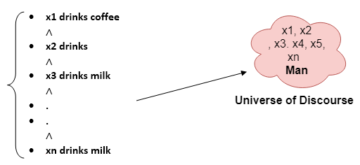
BITS Pilani
Pilani Campus
(some slides adapted from Stuart http://aima.cs.berkeley.edu/)
DSE CL 557 - Artificial and Computational Intelligence
#11. Inference in First Order Logic
Sunday, January 17, 2021
Dr. Saikishor Jangiti

Slide 130
Today
Inference in FOL
Unification & Lifting
Forward chaining
Backward Chaining
Resolution
Reference: Chapter 9 from AI: A modern approach (Russell, Norvig)

Slide 131
Universal instantiation (UI)
Every instantiation of a universally quantified sentence is entailed by it:
∀v α Subst({v/g}, α)
for any variable v and ground term g
E.g., ∀x King(x) ∧ Greedy(x) ⇒ Evil(x) yields:
King(John) ∧ Greedy(John) ⇒ Evil(John)
King(Richard) ∧ Greedy(Richard) ⇒ Evil(Richard)
King(Father(John)) ∧ Greedy(Father(John)) ⇒ Evil(Father(John))
.
.
.

Slide 132
Existential instantiation (EI)
For any sentence α, variable v, and constant symbol k that does not appear elsewhere in the knowledge base:
∃v α
Subst({v/k}, α)
E.g., ∃x Crown(x) ∧ OnHead(x,John) yields:
Crown(C₁) ∧ OnHead(C₁,John)
provided C₁ is a new constant symbol, called a Skolem constant

Slide 133
Reduction to propositional inference
Suppose the KB contains just the following:
∀x King(x) ∧ Greedy(x) ⇒ Evil(x)
King(John)
Greedy(John)
Brother(Richard,John)
Instantiating the universal sentence in all possible ways, we have:
King(John) ∧ Greedy(John) ⇒ Evil(John)
King(Richard) ∧ Greedy(Richard) ⇒ Evil(Richard)
King(John)
Greedy(John)
Brother(Richard,John)
The new KB is propositionalized: proposition symbols are
King(John), Greedy(John), Evil(John), King(Richard), etc.

Slide 134
Reduction contd.
Every FOL KB can be propositionalised so as to preserve entailment
(A ground sentence is entailed by new KB iff entailed by original KB)
Idea: propositionalize KB and query, apply resolution, return result
Problem: with function symbols, there are infinitely many ground terms,
e.g., Father(Father(Father(John)))

Slide 135
Reduction contd.
Theorem: Herbrand (1930). If a sentence α is entailed by an FOL KB, it is entailed by a finite subset of the propositionalized KB
Idea: For n = 0 to ∞ do
create a propositional KB by instantiating with depth-$n$ terms
see if α is entailed by this KB
Problem: works if α is entailed, loops if α is not entailed
Theorem: Turing (1936), Church (1936) Entailment for FOL is semidecidable (algorithms exist that say yes to every entailed sentence, but no algorithm exists that also says no to every nonentailed sentence.)

Slide 136
Problems with propositionalization
Propositionalization seems to generate lots of irrelevant sentences.
E.g., from:
∀x King(x) ∧ Greedy(x) ⇒ Evil(x)
King(John)
∀y Greedy(y)
Brother(Richard,John)
it seems obvious that Evil(John), but propositionalization produces lots of facts such as Greedy(Richard) that are irrelevant
With p k-ary predicates and n constants, there are p·n^{k} instantiations.

Slide 137
Unification
We can get the inference immediately if we can find a substitution θ such that King(x) and Greedy(x) match King(John) and Greedy(y)
θ = {x/John, y/John} works
Unify(α,β) = θ if αθ = βθ
p q θ
Knows(John,x) Knows(John,Jane)
Knows(John,x) Knows(y,OJ)
Knows(John,x) Knows(y,Mother(y))
Knows(John,x) Knows(x,OJ)
Standardizing apart eliminates overlap of variables, e.g., Knows(z₁₇,OJ)

Slide 138
Unification
We can get the inference immediately if we can find a substitution θ such that King(x) and Greedy(x) match King(John) and Greedy(y)
θ = {x/John,y/John} works
Unify(α,β) = θ if αθ = βθ
p q θ
Knows(John,x) Knows(John,Jane) {x/Jane}}
Knows(John,x) Knows(y,OJ)
Knows(John,x) Knows(y,Mother(y))
Knows(John,x) Knows(x,OJ)
Standardizing apart eliminates overlap of variables, e.g., Knows(z₁₇,OJ)

Slide 139
Unification
We can get the inference immediately if we can find a substitution θ such that King(x) and Greedy(x) match King(John) and Greedy(y)
θ = {x/John,y/John} works
Unify(α,β) = θ if αθ = βθ
p q θ
Knows(John,x) Knows(John,Jane) {x/Jane}}
Knows(John,x) Knows(y,OJ) {x/OJ,y/John}}
Knows(John,x) Knows(y,Mother(y))
Knows(John,x) Knows(x,OJ)
Standardizing apart eliminates overlap of variables, e.g., Knows(z₁₇,OJ)

Slide 140
Unification
We can get the inference immediately if we can find a substitution θ such that King(x) and Greedy(x) match King(John) and Greedy(y)
θ = {x/John,y/John} works
Unify(α,β) = θ if αθ = βθ
p q θ
Knows(John,x) Knows(John,Jane) {x/Jane}}
Knows(John,x) Knows(y,OJ) {x/OJ,y/John}}
Knows(John,x) Knows(y,Mother(y)) {y/John,x/Mother(John)}}
Knows(John,x) Knows(x,OJ)
Standardizing apart eliminates overlap of variables, e.g., Knows(z₁₇,OJ)

Slide 141
Unification
We can get the inference immediately if we can find a substitution θ such that King(x) and Greedy(x) match King(John) and Greedy(y)
θ = {x/John,y/John} works
Unify(α,β) = θ if αθ = βθ
p q θ
Knows(John,x) Knows(John,Jane) {x/Jane}}
Knows(John,x) Knows(y,OJ) {x/OJ,y/John}}
Knows(John,x) Knows(y,Mother(y)) {y/John,x/Mother(John)}}
Knows(John,x) Knows(x,OJ) {fail}
Standardizing apart eliminates overlap of variables, e.g., Knows(z₁₇,OJ)

Slide 142
Unification
To unify Knows(John,x) and Knows(y,z),
θ = {y/John, x/z } or θ = {y/John, x/John, z/John}
The first unifier is more general than the second.
There is a single most general unifier (MGU) that is unique up to renaming of variables.
MGU = { y/John, x/z }

Slide 143

The unification algorithm

Slide 144

The unification algorithm

Slide 145
Generalized Modus Ponens (GMP)
p₁', p₂', … , p_{n}', ( p₁ ∧ p₂ ∧ … ∧ p_{n} ⇒q)
qθ
p₁' is King(John) p₁ is King(x)
p₂' is Greedy(y) p₂ is Greedy(x)
θ is {x/John,y/John} q is Evil(x)
q θ is Evil(John)
GMP used with KB of definite clauses (exactly one positive literal)
All variables assumed universally quantified
where p_{i}'θ = p_{i} θ for all i

Slide 146
Soundness of GMP
Need to show that
p₁', …, p_{n}', (p₁ ∧ … ∧ p_{n} ⇒ q) ╞ qθ
provided that p_{i}'θ = p_{i}θ for all I
Lemma: For any sentence p, we have p ╞ pθ by UI
(p₁ ∧ … ∧ p_{n} ⇒ q) ╞ (p₁ ∧ … ∧ p_{n} ⇒ q)θ = (p₁θ ∧ … ∧ p_{n}θ ⇒ qθ)
p₁', \; …, \;p_{n}' ╞ p₁' ∧ … ∧ p_{n}' ╞ p₁'θ ∧ … ∧ p_{n}'θ
From 1 and 2, qθ follows by ordinary Modus Ponens

Slide 147
Example knowledge base
The law says that it is a crime for an American to sell weapons to hostile nations. The country Nono, an enemy of America, has some missiles, and all of its missiles were sold to it by Colonel West, who is American.
Prove that Col. West is a criminal

Slide 148
Example knowledge base contd.
... it is a crime for an American to sell weapons to hostile nations:
American(x) ∧ Weapon(y) ∧ Sells(x,y,z) ∧ Hostile(z) ⇒ Criminal(x)
Nono … has some missiles, i.e., ∃x Owns(Nono,x) ∧ Missile(x):
Owns(Nono,M₁) and Missile(M₁)
… all of its missiles were sold to it by Colonel West
Missile(x) ∧ Owns(Nono,x) ⇒ Sells(West,x,Nono)
Missiles are weapons:
Missile(x) ⇒ Weapon(x)
An enemy of America counts as "hostile“:
Enemy(x,America) ⇒ Hostile(x)
West, who is American …
American(West)
The country Nono, an enemy of America …
Enemy(Nono,America)

Slide 149

Forward chaining algorithm

Slide 150

Forward chaining proof

Slide 151

Forward chaining proof

Slide 152

Forward chaining proof

Slide 153
Properties of forward chaining
Sound and complete for first-order definite clauses
Datalog = first-order definite clauses + no functions
FC terminates for Datalog in finite number of iterations
May not terminate in general if α is not entailed
This is unavoidable: entailment with definite clauses is semidecidable

Slide 154
Efficiency of forward chaining
Incremental forward chaining: no need to match a rule on iteration k if a premise wasn't added on iteration k-1
⇒ match each rule whose premise contains a newly added positive literal
Matching itself can be expensive:
Database indexing allows O(1) retrieval of known facts
e.g., query Missile(x) retrieves Missile(M₁)
Forward chaining is widely used in deductive databases

Slide 155

Hard matching example
Diff(wa,nt) ∧ Diff(wa,sa) ∧ Diff(nt,q) ∧ Diff(nt,sa) ∧ Diff(q,nsw) ∧ Diff(q,sa) ∧ Diff(nsw,v) ∧ Diff(nsw,sa) ∧ Diff(v,sa) ⇒ Colorable()
Diff(Red,Blue) Diff (Red,Green) Diff(Green,Red) Diff(Green,Blue) Diff(Blue,Red) Diff(Blue,Green)
Colorable() is inferred iff the CSP has a solution
CSPs include 3SAT as a special case, hence matching is NP-hard

Slide 156

Backward chaining algorithm
SUBST(COMPOSE(θ₁, θ₂), p) = SUBST(θ₂, SUBST(θ₁, p))

Slide 157

Backward chaining example

Slide 158

Backward chaining example

Slide 159

Backward chaining example

Slide 160

Backward chaining example

Slide 161

Backward chaining example

Slide 162

Backward chaining example

Slide 163

Backward chaining example

Slide 164
Backward chaining example

Slide 165
Properties of backward chaining
Depth-first recursive proof search: space is linear in size of proof
Incomplete due to infinite loops
⇒ fix by checking current goal against every goal on stack
Inefficient due to repeated subgoals (both success and failure)
⇒ fix using caching of previous results (extra space)
Widely used for logic programming

Slide 166
Logic programming: Prolog
Algorithm = Logic + Control
Basis: backward chaining with Horn clauses + bells & whistles
Widely used in Europe, Japan (basis of 5th Generation project)
Compilation techniques ⇒ 60 million LIPS
Program = set of clauses = head :- literal₁, … literal_{n}.
criminal(X) :- american(X), weapon(Y), sells(X,Y,Z), hostile(Z).
Depth-first, left-to-right backward chaining
Built-in predicates for arithmetic etc., e.g., X is Y*Z+3
Built-in predicates that have side effects (e.g., input and output
predicates, assert/retract predicates)
Closed-world assumption ("negation as failure")
e.g., given alive(X) :- not dead(X).
alive(joe) succeeds if dead(joe) fails

Slide 167
Prolog
Appending two lists to produce a third:
append([],Y,Y).
append([X|L],Y,[X|Z]) :- append(L,Y,Z).
query: append(A,B,[1,2]) ?
answers: A=[] B=[1,2]
A=[1] B=[2]
A=[1,2] B=[]

Slide 168
Resolution: brief summary
Full first-order version:
l₁ ∨ ··· ∨ l_{k}, m₁ ∨ ··· ∨ m_{n}
(l₁ ∨ ··· ∨ l_{i-1} ∨ l_{i+1} ∨ ··· ∨ l_{k} ∨ m₁ ∨ ··· ∨ m_{j-1} ∨ m_{j+1} ∨ ··· ∨ m_{n})θ
where Unify(l_{i}, ¬m_{j}) = θ.
The two clauses are assumed to be standardized apart so that they share no variables.
For example,
¬Rich(x) ∨ Unhappy(x)
Rich(Ken)
Unhappy(Ken) with θ = {x/Ken}
Apply resolution steps to CNF(KB ∧ ¬α); complete for FOL

Slide 169
Conversion to CNF
Everyone who loves all animals is loved by someone:
∀x [∀y Animal(y) ⇒ Loves(x,y)] ⇒ [∃y Loves(y,x)]
1. Eliminate biconditionals and implications
∀x [¬∀y ¬Animal(y) ∨ Loves(x,y)] ∨ [∃y Loves(y,x)]
2. Move ¬ inwards: ¬∀x p ≡ ∃x ¬p, ¬ ∃x p ≡ ∀x ¬p
∀x [∃y ¬(¬Animal(y) ∨ Loves(x,y))] ∨ [∃y Loves(y,x)]
∀x [∃y ¬¬Animal(y) ∧ ¬Loves(x,y)] ∨ [∃y Loves(y,x)]
∀x [∃y Animal(y) ∧ ¬Loves(x,y)] ∨ [∃y Loves(y,x)]

Slide 170
Conversion to CNF contd.
Standardize variables: each quantifier should use a different one
∀x [∃y Animal(y) ∧ ¬Loves(x,y)] ∨ [∃z Loves(z,x)]
Skolemize: a more general form of existential instantiation.
Each existential variable is replaced by a Skolem function of the enclosing universally quantified variables:
∀x [Animal(F(x)) ∧ ¬Loves(x,F(x))] ∨ Loves(G(x),x)
Drop universal quantifiers:
[Animal(F(x)) ∧ ¬Loves(x,F(x))] ∨ Loves(G(x),x)
Distribute ∨ over ∧ : [Animal(F(x)) ∨ Loves(G(x),x)] ∧ [¬Loves(x,F(x)) ∨ Loves(G(x),x)]

Slide 171

Resolution proof: definite clauses

Slide 172
Thank you for your Attention
Any more queries

Slide 173

BITS Pilani
Pilani Campus
(some slides adapted from Stuart http://aima.cs.berkeley.edu/)
DSE CL 557 - Artificial and Computational Intelligence
#12. Probabilistic Representation and Reasoning
Sunday, January 17, 2021
Dr. Saikishor Jangiti

Slide 174
Today
Probabilistic Representation and Reasoning
Inference using full joint distribution & Example
Uncertainty
Probability
Syntax and Semantics
Inference
Independence and Bayes' Rule
Knowledge representation using Bayesian Networks, semantics of Bayesian Networks
Reference: Chapter 13, 14.1 & 14.2 from AI: A modern approach (Russell, Norvig)

Slide 175
Uncertainty
Let action A_{t} = leave for airport t minutes before flight
Will A_{t} get me there on time?
Problems:
partial observability (road state, other drivers' plans, etc.)
noisy sensors (traffic reports)
uncertainty in action outcomes (flat tire, etc.)
immense complexity of modeling and predicting traffic
Hence a purely logical approach either
risks falsehood: “A₂₅ will get me there on time”, or
leads to conclusions that are too weak for decision making:
“A₂₅ will get me there on time if there's no accident on the bridge and it doesn't rain and my tires remain intact etc.”
(A₁₄₄₀ might reasonably be said to get me there on time but I'd have to stay overnight in the airport …)

Slide 176
Methods for handling uncertainty
Default or nonmonotonic logic:
Assume my car does not have a flat tire
Assume A₂₅ works unless contradicted by evidence
Issues: What assumptions are reasonable? How to handle contradiction?
Rules with fudge factors:
A₂₅ |→_{0.3} get there on time
Sprinkler |→ _{0.99} WetGrass
WetGrass |→ _{0.7} Rain
Issues: Problems with combination, e.g., Sprinkler causes Rain??
Probability
Model agent's degree of belief
Given the available evidence,
A₂₅ will get me there on time with probability 0.04

Slide 177
Probability
Probabilistic assertions summarize effects of
laziness: failure to enumerate exceptions, qualifications, etc.
ignorance: lack of relevant facts, initial conditions, etc.
Subjective probability:
Probabilities relate propositions to agent's own state of knowledge
e.g., P(A₂₅ | no reported accidents) = 0.06
These are not assertions about the world
Probabilities of propositions change with new evidence:
e.g., P(A₂₅ | no reported accidents, 5 a.m.) = 0.15

Slide 178
Making decisions under uncertainty
Suppose I believe the following:
P(A₂₅ gets me there on time | …) = 0.04
P(A₉₀ gets me there on time | …) = 0.70
P(A₁₂₀ gets me there on time | …) = 0.95
P(A₁₄₄₀ gets me there on time | …) = 0.9999
Which action to choose? Depends on my preferences for missing flight vs. time spent waiting, etc.
Utility theory is used to represent and infer preferences
Decision theory = probability theory + utility theory

Slide 179
Syntax
Basic element: random variable
Similar to propositional logic: possible worlds defined by assignment of values to random variables.
Boolean random variables
e.g., Cavity (do I have a cavity?)
Discrete random variables
e.g., Weather is one of <sunny,rainy,cloudy,snow>
Domain values must be exhaustive and mutually exclusive
Elementary proposition constructed by assignment of a value to a random variable: e.g., Weather = sunny, Cavity = false (abbreviated as ¬cavity)
Complex propositions formed from elementary propositions and standard logical connectives e.g., Weather = sunny ∨ Cavity = false

Slide 180
Syntax
Atomic event: A complete specification of the state of the world about which the agent is uncertain
E.g., if the world consists of only two Boolean variables Cavity and Toothache, then there are 4 distinct atomic events:
Cavity = false ∧Toothache = false
Cavity = false ∧ Toothache = true
Cavity = true ∧ Toothache = false
Cavity = true ∧ Toothache = true
Atomic events are mutually exclusive and exhaustive

Slide 181

Axioms of probability
For any propositions A, B
0 ≤ P(A) ≤ 1
P(true) = 1 and P(false) = 0
P(A ∨ B) = P(A) + P(B) - P(A ∧ B)

Slide 182
Prior probability
Prior or unconditional probabilities of propositions
e.g., P(Cavity = true) = 0.1 and P(Weather = sunny) = 0.72 correspond to belief prior to arrival of any (new) evidence
Probability distribution gives values for all possible assignments:
P(Weather) = <0.72,0.1,0.08,0.1> (normalized, i.e., sums to 1)
Joint probability distribution for a set of random variables gives the probability of every atomic event on those random variables
P(Weather,Cavity) = a 4 × 2 matrix of values:
Weather = sunny rainy cloudy snow
Cavity = true 0.144 0.02 0.016 0.02
Cavity = false 0.576 0.08 0.064 0.08
Every question about a domain can be answered by the joint distribution

Slide 183
Conditional probability
Conditional or posterior probabilities
e.g., P(cavity | toothache) = 0.8
i.e., given that toothache is all I know
(Notation for conditional distributions:
P(Cavity | Toothache) = 2-element vector of 2-element vectors)
If we know more, e.g., cavity is also given, then we have
P(cavity | toothache, cavity) = 1
New evidence may be irrelevant, allowing simplification, e.g.,
P(cavity | toothache, sunny) = P(cavity | toothache) = 0.8
This kind of inference, sanctioned by domain knowledge, is crucial

Slide 184
Conditional probability
Definition of conditional probability:
P(a | b) = P(a ∧ b) / P(b) if P(b) > 0
Product rule gives an alternative formulation:
P(a ∧ b) = P(a | b) P(b) = P(b | a) P(a)
A general version holds for whole distributions, e.g.,
P(Weather, Cavity) = P(Weather | Cavity) P(Cavity)
(View as a set of 4 × 2 equations, not matrix mult.)
Chain rule is derived by successive application of product rule:
P(X₁, …,X_{n}) = P(X₁,...,X_{n-1}) P(X_{n} | X₁,...,X_{n-1})
= P(X₁,...,X_{n-2}) P(X_{n-1} | X₁,...,X_{n-2}) P(X_{n} | X₁,...,X_{n-1})
= …
= π_{i= 1}^n P(X_{i} | X₁, … ,X_{i-1})

Slide 185

Inference by enumeration
Start with the joint probability distribution:
For any proposition φ, sum the atomic events where it is true: P(φ) = Σ_{ω:ω╞φ} P(ω)

Slide 186

Inference by enumeration
Start with the joint probability distribution:
For any proposition φ, sum the atomic events where it is true: P(φ) = Σ_{ω:ω╞φ} P(ω)
P(toothache) = 0.108 + 0.012 + 0.016 + 0.064 = 0.2

Slide 187

Inference by enumeration
Start with the joint probability distribution:
For any proposition φ, sum the atomic events where it is true: P(φ) = Σ_{ω:ω╞φ} P(ω)
P(toothache) = 0.108 + 0.012 + 0.016 + 0.064 = 0.2

Slide 188

Inference by enumeration
Start with the joint probability distribution:
Can also compute conditional probabilities:
P(¬cavity | toothache) = P(¬cavity ∧ toothache)
P(toothache)
= 0.016+0.064
0.108 + 0.012 + 0.016 + 0.064
= 0.4

Slide 189

Normalization
Denominator can be viewed as a normalization constant α
P(Cavity | toothache) = α, P(Cavity,toothache)
= α, [P(Cavity,toothache,catch) + P(Cavity,toothache,¬ catch)]
= α, [<0.108,0.016> + <0.012,0.064>]
= α, <0.12,0.08> = <0.6,0.4>
General idea: compute distribution on query variable by fixing evidence variables and summing over hidden variables

Slide 190
Inference by enumeration, contd.
Typically, we are interested in
the posterior joint distribution of the query variables Y
given specific values e for the evidence variables E
Let the hidden variables be H = X - Y - E
Then the required summation of joint entries is done by summing out the hidden variables:
P(Y | E = e) = αP(Y,E = e) = αΣ_{h}P(Y,E= e, H = h)
The terms in the summation are joint entries because Y, E and H together exhaust the set of random variables
Obvious problems:
Worst-case time complexity O(d^{n}) where d is the largest arity
Space complexity O(d^{n}) to store the joint distribution
How to find the numbers for O(d^{n}) entries?

Slide 191

Independence
A and B are independent iff
P(A|B) = P(A) or P(B|A) = P(B) or P(A, B) = P(A) P(B)
P(Toothache, Catch, Cavity, Weather)
= P(Toothache, Catch, Cavity) P(Weather)
32 entries reduced to 12; for n independent biased coins, O(2^{n}) →O(n)
Absolute independence powerful but rare
Dentistry is a large field with hundreds of variables, none of which are independent. What to do?

Slide 192
Conditional independence
P(Toothache, Cavity, Catch) has 2³ – 1 = 7 independent entries
If I have a cavity, the probability that the probe catches in it doesn't depend on whether I have a toothache:
(1) P(catch | toothache, cavity) = P(catch | cavity)
The same independence holds if I haven't got a cavity:
(2) P(catch | toothache,¬cavity) = P(catch | ¬cavity)
Catch is conditionally independent of Toothache given Cavity:
P(Catch | Toothache,Cavity) = P(Catch | Cavity)
Equivalent statements:
P(Toothache | Catch, Cavity) = P(Toothache | Cavity)
P(Toothache, Catch | Cavity) = P(Toothache | Cavity) P(Catch | Cavity)

Slide 193
Conditional independence contd.
Write out full joint distribution using chain rule:
P(Toothache, Catch, Cavity)
= P(Toothache | Catch, Cavity) P(Catch, Cavity)
= P(Toothache | Catch, Cavity) P(Catch | Cavity) P(Cavity)
= P(Toothache | Cavity) P(Catch | Cavity) P(Cavity)
I.e., 2 + 2 + 1 = 5 independent numbers
In most cases, the use of conditional independence reduces the size of the representation of the joint distribution from exponential in n to linear in n.
Conditional independence is our most basic and robust form of knowledge about uncertain environments.

Slide 194
Bayes' Rule
Product rule P(a∧b) = P(a | b) P(b) = P(b | a) P(a)
⇒ Bayes' rule: P(a | b) = P(b | a) P(a) / P(b)
or in distribution form
P(Y|X) = P(X|Y) P(Y) / P(X) = αP(X|Y) P(Y)
Useful for assessing diagnostic probability from causal probability:
P(Cause|Effect) = P(Effect|Cause) P(Cause) / P(Effect)
E.g., let M be meningitis, S be stiff neck:
P(m|s) = P(s|m) P(m) / P(s) = 0.8 × 0.0001 / 0.1 = 0.0008
Note: posterior probability of meningitis still very small!

Slide 195

Bayes' Rule and conditional independence
P(Cavity | toothache ∧ catch)
= αP(toothache ∧ catch | Cavity) P(Cavity)
= αP(toothache | Cavity) P(catch | Cavity) P(Cavity)
This is an example of a naïve Bayes model:
P(Cause,Effect₁, … ,Effect_{n}) = P(Cause) π_{i}P(Effect_{i}|Cause)
Total number of parameters is linear in n

Slide 196
Summary
Probability is a rigorous formalism for uncertain knowledge
Joint probability distribution specifies probability of every atomic event
Queries can be answered by summing over atomic events
For nontrivial domains, we must find a way to reduce the joint size
Independence and conditional independence provide the tools

Slide 197
Knowledge representation using Bayesian Networks, semantics of Bayesian Networks

Slide 198
Outline
Syntax
Semantics

Slide 199
Bayesian networks
A simple, graphical notation for conditional independence assertions and hence for compact specification of full joint distributions
Syntax:
a set of nodes, one per variable
a directed, acyclic graph (link ≈ "directly influences")
a conditional distribution for each node given its parents:
P (X_{i} | Parents (X_{i}))
In the simplest case, conditional distribution represented as a conditional probability table (CPT) giving the distribution over X_{i} for each combination of parent values

Slide 200

Example
Topology of network encodes conditional independence assertions:
Weather is independent of the other variables
Toothache and Catch are conditionally independent given Cavity

Slide 201
Example
I'm at work, neighbor John calls to say my alarm is ringing, but neighbor Mary doesn't call. Sometimes it's set off by minor earthquakes. Is there a burglar?
Variables: Burglary, Earthquake, Alarm, JohnCalls, MaryCalls
Network topology reflects "causal" knowledge:
A burglar can set the alarm off
An earthquake can set the alarm off
The alarm can cause Mary to call
The alarm can cause John to call

Slide 202

Example contd.

Slide 203

Compactness
A CPT for Boolean X_{i} with k Boolean parents has 2^{k} rows for the combinations of parent values
Each row requires one number p for X_{i} = true (the number for X_{i} = false is just 1-p)
If each variable has no more than k parents, the complete network requires O(n · 2^{k}) numbers
I.e., grows linearly with n, vs. O(2^{n}) for the full joint distribution
For burglary net, 1 + 1 + 4 + 2 + 2 = 10 numbers (vs. 2⁵-1 = 31)

Slide 204
Semantics
The full joint distribution is defined as the product of the local conditional distributions:
P (X₁, … ,X_{n}) = π_{i = 1} P (X_{i} | Parents(X_{i}))
e.g., P(j ∧ m ∧ a ∧ ¬b ∧ ¬e)
= P (j | a) P (m | a) P (a | ¬b, ¬e) P (¬b) P (¬e)

Slide 205
Thank you for your Attention
Any more queries

Slide 206
BITS Pilani
Pilani Campus
(some slides adapted from Stuart http://aima.cs.berkeley.edu/)
DSE CL 557 - Artificial and Computational Intelligence
#13. Probabilistic Representation and Reasoning – Contd..
Sunday, January 17, 2021
Dr. Saikishor Jangiti

Slide 207
Today
Probabilistic Representation and Reasoning
Representation of Conditional Independence using BN
Exact Inference - by enumeration and variable elimination
Need for Approximate Inference - direct Sampling
Reference: Chapter 13, 14.1 & 14.2 from AI: A modern approach (Russell, Norvig)

Slide 208
Bayesian networks
A simple, graphical notation for conditional independence assertions and hence for compact specification of full joint distributions
Syntax:
a set of nodes, one per variable
a directed, acyclic graph (link ≈ "directly influences")
a conditional distribution for each node given its parents:
P (X_{i} | Parents (X_{i}))
In the simplest case, conditional distribution represented as a conditional probability table (CPT) giving the distribution over X_{i} for each combination of parent values

Slide 209
Example
Topology of network encodes conditional independence assertions:
Weather is independent of the other variables
Toothache and Catch are conditionally independent given Cavity

Slide 210
Example
I'm at work, neighbor John calls to say my alarm is ringing, but neighbor Mary doesn't call. Sometimes it's set off by minor earthquakes. Is there a burglar?
Variables: Burglary, Earthquake, Alarm, JohnCalls, MaryCalls
Network topology reflects "causal" knowledge:
A burglar can set the alarm off
An earthquake can set the alarm off
The alarm can cause Mary to call
The alarm can cause John to call

Slide 211
Example contd.

Slide 212
Compactness
A CPT for Boolean X_{i} with k Boolean parents has 2^{k} rows for the combinations of parent values
Each row requires one number p for X_{i} = true (the number for X_{i} = false is just 1-p)
If each variable has no more than k parents, the complete network requires O(n · 2^{k}) numbers
I.e., grows linearly with n, vs. O(2^{n}) for the full joint distribution
For burglary net, 1 + 1 + 4 + 2 + 2 = 10 numbers (vs. 2⁵-1 = 31)

Slide 213
Semantics
The full joint distribution is defined as the product of the local conditional distributions:
P (X₁, … ,X_{n}) = π_{i = 1} P (X_{i} | Parents(X_{i}))
e.g., P(j ∧ m ∧ a ∧ ¬b ∧ ¬e)
= P (j | a) P (m | a) P (a | ¬b, ¬e) P (¬b) P (¬e)

Slide 214
Constructing Bayesian networks
1. Choose an ordering of variables X₁, … ,X_{n}
2. For i = 1 to n
add X_{i} to the network
select parents from X₁, … ,X_{i-1} such that
P (X_{i} | Parents(X_{i})) = P (X_{i} | X₁, ... X_{i-1})
This choice of parents guarantees:
P (X₁, … ,X_{n}) = π_{i =1} P (X_{i} | X₁, … , X_{i-1}) (chain rule)
= π_{i =1}P (X_{i} | Parents(X_{i})) (by construction)

Slide 215

Example
Suppose we choose the ordering M, J, A, B, E
P(J | M) = P(J)?

Slide 216

Example
Suppose we choose the ordering M, J, A, B, E
P(J | M) = P(J)? No
P(A | J, M) = P(A | J)? P(A | J, M) = P(A)?

Slide 217

Example
Suppose we choose the ordering M, J, A, B, E
P(J | M) = P(J)?No
P(A | J, M) = P(A | J)?
P(A | J, M) = P(A)? No
P(B | A, J, M) = P(B | A)?
P(B | A, J, M) = P(B)?

Slide 218

Example
Suppose we choose the ordering M, J, A, B, E
P(J | M) = P(J)? No
P(A | J, M) = P(A | J)? P(A | J, M) = P(A)? No
P(B | A, J, M) = P(B | A)? Yes
P(B | A, J, M) = P(B)? No
P(E | B, A ,J, M) = P(E | A)?
P(E | B, A, J, M) = P(E | A, B)?

Slide 219

Example
Suppose we choose the ordering M, J, A, B, E
P(J | M) = P(J)? No
P(A | J, M) = P(A | J)? P(A | J, M) = P(A)? No
P(B | A, J, M) = P(B | A)? Yes
P(B | A, J, M) = P(B)? No
P(E | B, A ,J, M) = P(E | A)? No
P(E | B, A, J, M) = P(E | A, B)? Yes

Slide 220
Example contd.
Deciding conditional independence is hard in noncausal directions
(Causal models and conditional independence seem hardwired for humans!)
Network is less compact: 1 + 2 + 4 + 2 + 4 = 13 numbers needed

Slide 221
Some special cases in Network Construction – Noisy OR

Slide 222
Some special cases in Network Construction – Noisy OR

Slide 223
Some special cases in Network Construction – Noisy OR

Slide 224
Handling continuous distributions

Slide 225
Applications

Slide 226
Inference Tasks

Slide 227
Inference by enumeration

Slide 228
Inference by enumeration

Slide 229
Inference by enumeration

Slide 230
Variable elimination

Slide 231
Variable elimination

Slide 232
Variable elimination

Slide 233
Variable elimination

Slide 234
Irrelevant variables

Slide 235
Complexity of Exact Inference

Slide 236
Summary
Bayesian networks provide a natural representation for (causally induced) conditional independence
Topology + CPTs = compact representation of joint distribution
Generally easy for domain experts to construct

Slide 237
Thank you for your Attention
Any more queries

Slide 238

BITS Pilani
Pilani Campus
(some slides adapted from Stuart http://aima.cs.berkeley.edu/)
DSE CL 557 - Artificial and Computational Intelligence
#14. Reasoning over time – Hidden Markov Model
Sunday, January 17, 2021
Dr. Saikishor Jangiti

Slide 239
Today
Reasoning over time
Time and Uncertainty
Inference in temporal models
Overview of HMM
Reference: Chapter 15.1 to 15.3 from AI: A modern approach (Russell, Norvig)

Slide 240
Probabilistic reasoning over time
... means to keep track of the current state of
a process (temperature controller, other controllers)
an agent with respect to the world (localisation of a robot in some “world”)
in order to make predictions or to simply understand what might have caused this current state.

Slide 241
Probabilistic reasoning over time
This involves both
a transition model (how the state is assumed to change)
a sensor model (how observations / percepts are related to the world state).
Previously:
the focus was on what was possible to happen (e.g., search), now it is on what is likely / unlikely to happen
the focus was on static worlds (Bayesian networks), now we look at dynamic processes where everything (state AND observations) depend on time.

Slide 242
Three classes of approaches
Hidden Markov models
Kalman filters
Dynamic Bayesian networks (cover actually the other two as special cases)

Slide 243
Reasoning over time
With
Xt the current state description at time t
Et the evidence obtained at time t
we can describe a state transition model and a sensor model that we can use to model a time step sequence - a chain of states and sensor readings according to discrete time steps - so that we can understand the ongoing process.

Slide 244
Reasoning over time
We assume to start out in X0, but evidence will only arrive after the first state transition is made: E1 is then the first piece of evidence to be plugged into the chain.
The “general” transition model would then specify
ℙ( Xt | X0:t-1)
... this would mean we need full joint distributions over all time steps... or not?

Slide 245

The Markov assumption
A process is Markov (i.e., complies with the Markov assumption), when any given state Xt depends only on a finite and fixed number of previous states.

Slide 246

A first-order Markov chain as Bayesian network

Slide 247

Inference for any t

Slide 248

Reasoning over Time or Space
Often, we want to reason about a sequence of observations
Speech recognition
Robot localization
User attention
Medical monitoring
Need to introduce time (or space) into our models

Slide 249


Markov Models
Value of X at a given time is called the state
Parameters: called transition probabilities or dynamics, specify how the state evolves over time (also, initial state probabilities)
Stationarity assumption: transition probabilities the same at all times
Same as MDP transition model, but no choice of action
A (growable) BN: We can always use generic BN reasoning on it if we truncate the chain at a fixed length
X₁
X₂
X₃
X₄

Slide 250

Markov Assumption: Conditional Independence
Basic conditional independence:
Past and future independent given the present
Each time step only depends on the previous
This is called the (first order) Markov property

Slide 251

Example Markov Chain: Weather
States: X = {rain, sun}
Initial distribution: 1.0 sun
CPT P(X_{t} | X_{t-1}):
Two new ways of representing the same CPT
X_{t-1} | X_{t} | P(X_{t}|X_{t-1})
sun | sun | 0.9
sun | rain | 0.1
rain | sun | 0.3
rain | rain | 0.7
0.9
0.3
0.9
rain
sun
sun
sun
0.1
0.3
rain
rain
0.7
0.7
0.1

Slide 252
Example Markov Chain: Weather
0.9
0.3
Initial distribution: 1.0 sun
What is the probability distribution after one step?
rain
sun
0.7
0.1

Slide 253


Mini-Forward Algorithm
Question: What’s P(X) on some day t?
X₁
X₂
X₃
X₄
Forward simulation

Slide 254










Example Run of Mini-Forward Algorithm
From initial observation of sun
From initial observation of rain
From yet another initial distribution P(X₁):
P(X₁)
P(X₂)
P(X₃)
P(X₄)
P(X∞)
P(X₁)
P(X₂)
P(X₃)
P(X₄)
P(X∞)
…
P(X₁)
P(X∞)
[Demo: L13D1,2,3]

Slide 255

Stationary Distributions
For most chains:
Influence of the initial distribution gets less and less over time.
The distribution we end up in is independent of the initial distribution
Stationary distribution:
The distribution we end up with is called the stationary distribution of the chain
It satisfies

Slide 256

Example: Stationary Distributions
Question: What’s P(X) at time t = infinity?
X₁
X₂
X₃
X₄
X_{t-1} | X_{t} | P(X_{t}|X_{t-1})
sun | sun | 0.9
sun | rain | 0.1
rain | sun | 0.3
rain | rain | 0.7
Also:

Slide 257

Application of Stationary Distribution: Web Link Analysis
PageRank over a web graph
Each web page is a possible value of a state
Initial distribution: uniform over pages
Transitions:
With prob. c, uniform jump to a
random page (dotted lines, not all shown)
With prob. 1-c, follow a random
outlink (solid lines)
Stationary distribution
Will spend more time on highly reachable pages
E.g. many ways to get to the Acrobat Reader download page
Somewhat robust to link spam.
Google 1.0 returned the set of pages containing all your keywords in decreasing rank, now all search engines use link analysis along with many other factors (rank actually getting less important over time)
Notes:
Before: most search engines were merely based on how well a page matches your search words.
Note: currently dominated by clickstreams

Slide 258

Hidden Markov Models

Slide 259
Why Hidden, Markov Model?
The reason it is called a Hidden Markov Model is because we are constructing an inference model based on the assumptions of a Markov process.
The Markov process assumption is simply that the “future is independent of the past given the present”.
In other words, assuming we know our present state, we do not need any other historical information to predict the future state.

Slide 260

Why Hidden, Markov Model?

Slide 261
Hidden Markov Models
Markov chains not so useful for most agents
Need observations to update your beliefs
Hidden Markov models (HMMs)
Underlying Markov chain over states X
You observe outputs (effects) at each time step
X₁
X₂
X₃
X₄
X₅
E₁
E₂
E₃
E₄
E₅

Slide 262


Example: Weather HMM
Rain_{t-1}
Rain_{t}
Rain_{t+1}
Umbrella_{t-1}
Umbrella_{t}
Umbrella_{t+1}
An HMM is defined by:
Initial distribution:
Transitions:
Emissions:
R_{t} | U_{t} | P(U_{t}|R_{t})
+r | +u | 0.9
+r | -u | 0.1
-r | +u | 0.2
-r | -u | 0.8
R_{t-1} | R_{t} | P(R_{t}|R_{t-1})
+r | +r | 0.7
+r | -r | 0.3
-r | +r | 0.3
-r | -r | 0.7
Notes:
demo

Slide 263


Example: Ghostbusters HMM
P(X₁) = uniform
P(X|X’) = usually move clockwise, but sometimes move in a random direction or stay in place
P(R_{ij}|X) = same sensor model as before: red means close, green means far away.
1/9
1/9
1/9
1/9
1/9
1/9
1/9
1/9
1/9
P(X₁)
1/6
1/6
1/2
0
1/6
0
X₁
X₂
X₃
X₄
0
0
0
X₅
P(X|X’=<1,2>)
R_{i,j}
R_{i,j}
R_{i,j}
R_{i,j}
Notes:
Dan has some demo for this.

Slide 264
Conditional Independence
HMMs have two important independence properties:
Markov hidden process: future depends on past via the present
Current observation independent of all else given current state
Does this mean that evidence variables are guaranteed to be independent?
[No, they tend to correlated by the hidden state]
X₁
X₂
X₃
X₄
X₅
E₁
E₂
E₃
E₄
E₅

Slide 265
Real HMM Examples
Robot tracking:
Observations are range readings (continuous)
States are positions on a map (continuous)
Speech recognition HMMs:
Observations are acoustic signals (continuous valued)
States are specific positions in specific words (so, tens of thousands)
Machine translation HMMs:
Observations are words (tens of thousands)
States are translation options

Slide 266
Filtering / Monitoring
Filtering, or monitoring, is the task of tracking the distribution B_{t}(X) = P_{t}(X_{t} | e₁, …, e_{t}) (the belief state) over time
We start with B₁(X) in an initial setting, usually uniform
As time passes, or we get observations, we update B(X)
The Kalman filter was invented in the 60’s and first implemented as a method of trajectory estimation for the Apollo program
Notes:
Dan has some demo for this

Slide 267
Thank you for your Attention
Any more queries

